Slide 1
Java Script - Team project “Black Jack”
Name: Team “EIRENE”
Sofia
2014

Slide 2
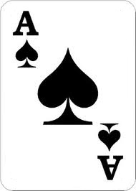
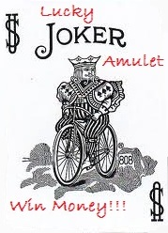
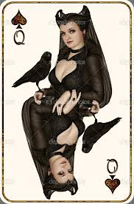
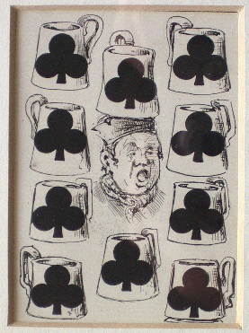
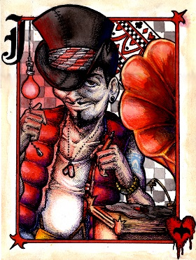
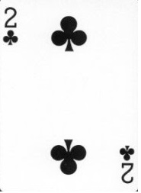


Team “EIRENE”
The Players:
Мартин Цветков
Васил Павлов
Живко Ангелов
Мария Николова
Анатоли Асенов
Никола Чакаров

Slide 3
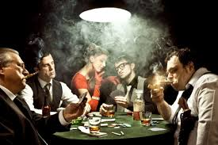

What is the game?
If (you ready
to play with us){
Object you = BLACKJACK.PLAYER;
}

